Slide 1
Psychotherapy and Neuroscience: Evidence and Challenges for CBT

Slide 2
"Bodily stimulation has effects on brain processing "
Claudia Höpfner
Berlin
Notes:
Hi, My name is Claudia Höpfner, I have studied psychology in Halle and at Free University of Berlin. I live in Berlin.
I am going to tell you a story about the effects of bodily stimulation on the brain.

Slide 3
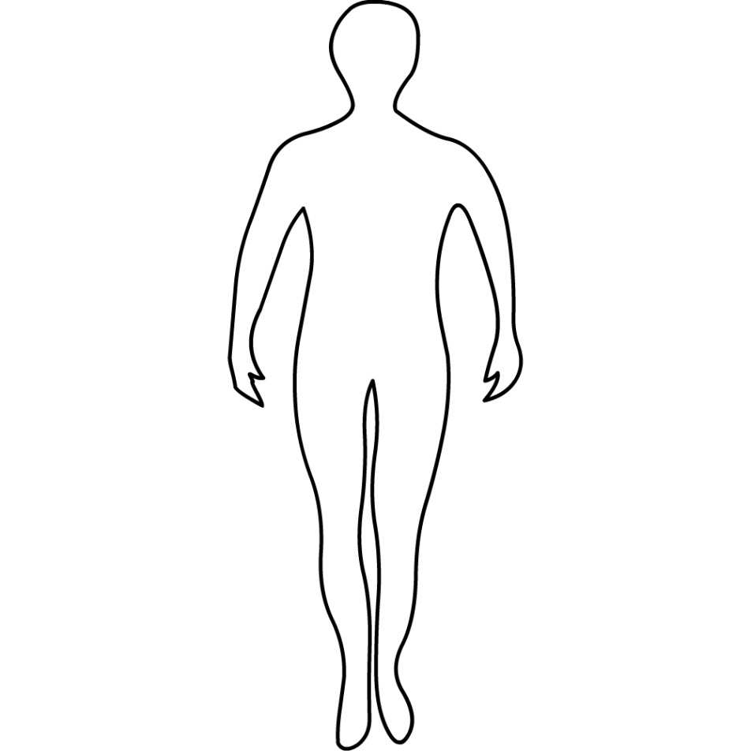
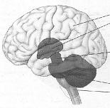
EABCT
Behaviour → → →
Cognition
Notes:
So we find ourselves here ate the congress of the european association for behavioral and cognitive therapies.
So, dealing with
a) Behavior and b) cognition

Slide 4
→ → →
Notes:
And as far as I know this is about rewards? and
The question: what moves us?

Slide 5
?
Behaviour → → →
Notes:
Dealing with human behavior, and the process of changing it to the better we need to consider what the biggest natural reward is.

Slide 6
Notes:
…. hold out..

Slide 7
"Bodily stimulation has effects on brain processing "
7
orgasm
Notes:
Is an orgasm! May be….
"Bodily stimulation has effects on brain processing "

Slide 8
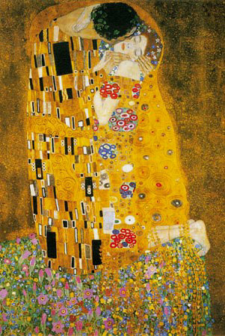
a kiss…
Notes:
…NOT. May be it‘s a kiss by the one you love….

Slide 9
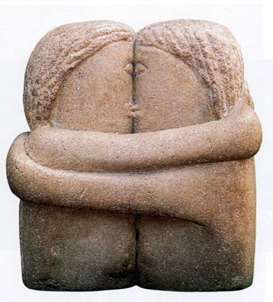
..a warm embrace
Notes:
…or a hug, simple and connecting.

Slide 10
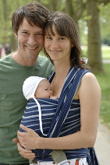
Body contact makes
reproduction
Mating
Child rearing

Slide 11
Chugani, 1998
Study of cerebral glucose utilization with PET
The first areas with notable activity in humans
→Somatosensory!!!
+Hippocampus
+Thalamus
+Cingulate cortex
+Motor cortex

Slide 12
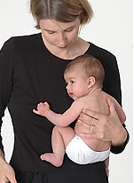
human = parent clinger /„Tragling“

Slide 13
Concept formation and formation of behavioral and attentional system are based on bodily ‚conditioning‘ therapeutic challenge?!

Slide 14
‚check‘ Kerstin Uvnäs-Moberg
Healthy couples by body contacts
Mediated by Oxytocin
Oxytocin is induced by warmth and lively skin/stomach stimulation (like an embrace)
High intent in suicide attempters comes with lower oxytocin level! (Uvnäs-Moberg, 2012)

Slide 15
EEG
Memory = ‚psychological functioning‘
Alpha rhythm = semantic memory
Theta rhythm = episodic memory
(Klimesch et al., 1994)
Alpha, theta and ‚somatic‘ sense:
tactile alpha orchestrates cortical activation (Hassler, 1971)
tactile stimulus only one not to be habituated in the
hippocampus (Whishaw et al., 1984)
Chugani, 1998

Slide 16
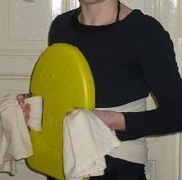
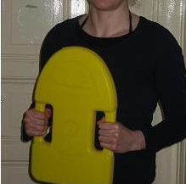
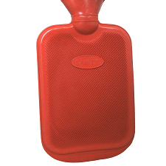
study
Group 1
Group 2
Soft
blanket

Slide 17
hypotheses…
… more alpha and theta in the group WITH body stimuli

Slide 18
EEG
Before (baseline)
Test
Task
Other, easy task - stimuli off
→logistic regression analysis

Slide 19
results
Relative rise of alpha during test and after (transfer!! effect)
Hightened theta after (‚easy‘ task)
→ in the right hemisphere.. Attachment!!! ‚Limbic‘! – check Allan Schore, Orrin Devinsky

Slide 20
Challenge!
The inner working model or ‚parts‘ of psychic imbalance might be based on experience before full awareness..
HOW TO GAIN ACCESS IN CBT?

Slide 21
Important issues!
How to cure traumatic body experience:
Body contact is a fragile process!!
Massage routines can help (autism, depression)
Integrate methods of body therapy?
Maybe we don‘t need more neurosciece, but less cognition… human needs!! → parent clinger…
…therapists need to be eclectic??!

Slide 22
„There‘s nothing here
till we have someone to hold.“*

Slide 23
Read more: (+ references)
www.humanformula.info
Thank you for your attention!!
says Claudia Höpfner

